Slide 1

String Manipulation
Lecturer
Rokas Slaboševičius
Data

Slide 2

Today you will learn
String Manipulation
Char Array
01
String checks and formatting
02
String methods
03

Slide 3


Char Array
String Manipulation
Char is a C# programming language data type for storing the meaning of a single letter or character.
Char type values are enclosed in single quotes, e.g. 'A', 'b', '#' etc.
A value of type Char is 16 bits in size and can be used as a single character or as part of a character sequence (string) in manipulations.

Slide 4
Char Array
String Manipulation
Values of type char can be used inside an object of type string. Each character in a string is individually accessible by its index.
For example, if we have the string "Hi", we can access the first letter 'L' using the cursor [0].
We can also modify the string characters by assigning new values of type char. For example, we can change the string "Hi" to "Rab" by changing the first letter from 'L' to 'R'.

Slide 5
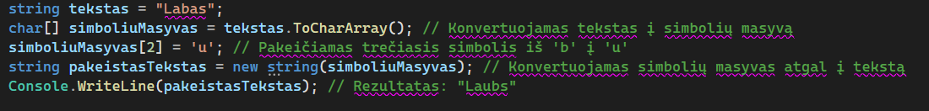
Char Array
String Manipulation
Thus, char-type values allow manipulation and actions on individual characters in strings.
It is possible to access and modify characters in strings using values of type char.
In addition, char values can be compared and sorted, providing more possibilities for manipulating and analysing text in applications.

Slide 6
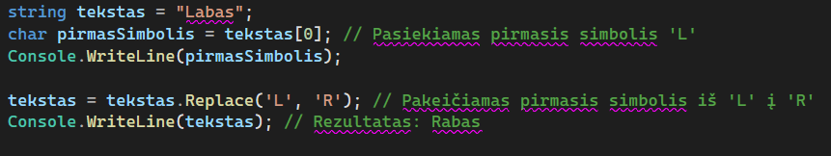
Char Array
String Manipulation
Thus, char-type values allow manipulation and actions on individual characters in strings.
It is possible to access and modify characters in strings using values of type char.
In addition, char values can be compared and sorted, providing more possibilities for manipulating and analysing text in applications.

Slide 7

String Manipulation
Task 1
Ask the user to enter the text. The first letter of the text should be changed to a capital letter.
Ask the user to enter the text, but you have to change the characters 2,4,6,8 and 10 to:
2 - g
4 - b
6 - *
8 - x
10 - w
Write a program that asks the user to enter text of 5 characters. Check if less or more is entered. Ask the user how they would like to encode their message. Add the resulting number to the text for each individual char and print the encoded message on the screen.

Slide 8
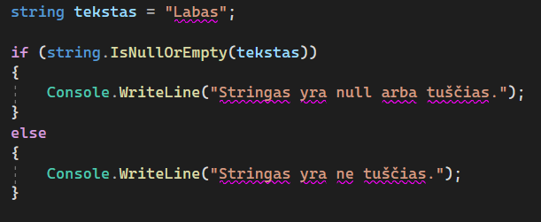
String checks and formatting
String Manipulation
Checking whether a string is null or empty is an important step in the program to ensure proper data processing. There are several ways to do this.
First, we can use the method string.IsNullOrEmpty(), which checks whether a string is null or empty. For example:

Slide 9
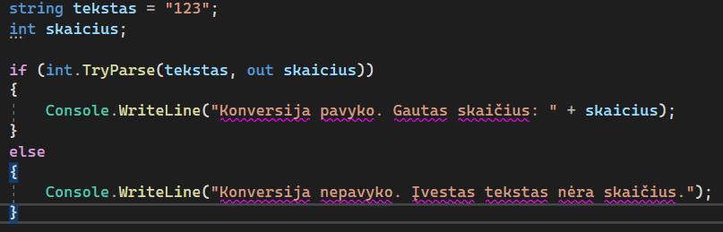
String checks and formatting
String Manipulation
The TryParse() method is very useful when you need to convert text to another data type, e.g. a number or a date, while avoiding possible conversion errors. This method is designed to check whether the conversion succeeded or failed and return the result as a value of type bool.
For example, using int.TryParse(), we can try to convert text to an integer and see if it works:

Slide 10
String methods
String Manipulation
Clone Can clone an existing string and return a new string object.
CompareTo Compares two strings and returns the result of the comparison (positive if the first string is greater, negative if the second string is greater, or null if the strings are equal).
Contains Checks whether the string contains the specified character or text and returns the result (true or false).
EndsWith Checks if the string ends with the specified character or text fragment and returns the result (true or false).
Equals Checks if two strings are equal and returns the result (true or false).
IndexOf Finds the index of the first occurring character or text fragment in the string and returns the result (-1 if not found).
ToLower() Converts all characters in the string to lower case.
ToUpper() Converts all string characters to uppercase.
LastIndexOf Finds the index of the last occurring character or text fragment in the string and returns the result (-1 if not found).
Length Returns the number of characters in the string.
Count(x => x == "a") Counts the number of times the specified character or text is repeated in the string.
Remove Removes the specified character or text fragment from the string.
Replace Replaces all occurrences of specified characters or text in the string with new characters or text.
Split Splits the string according to the specified separator character and returns the result as an array of individual fragments.
Substring Constructs a new string object that is a fragment of the specified text from the start index to the end index (you can specify only the start index, get to the end index, or from the start index to a certain length).
Trim Removes leading and trailing spaces (or specified characters) from the string.

Slide 11
String Manipulation
Task 2
Write a program that asks the user for a sentence. In that sentence, replace all the letters "a" with "uo". In the same sentence, change all the letters 'i' to 'e'.
Create a program that accepts text (poem or lyrics). It then asks the user what word they would like to change to another word given by the user. The updated text should be displayed on the screen.
Design a program to calculate how many days, weeks, months and years a user has left before they turn 90. At the very beginning, do not forget to ask the user to enter how old they are now.

Slide 12
String Manipulation
Task 3
Create an application that accepts a word entered by the user and checks whether it starts with a capital letter. If it does, print the word in capital letters, if not, change the first letter to capital and print the word. Use the ToUpper() and Substring() methods.
Create a program that accepts a word entered by the user and checks whether it contains the character 'a'. If so, print the word together with the index of the character 'a' using the IndexOf() method. If the character is not found, print the message "Character 'a' not found".
Create an application that accepts a word entered by the user and checks if it is "hello". If so, print the word backwards using the Reverse() method. If the word does not match "hello", print the word as it was entered.

Slide 13
String Manipulation
Task 4
Create a Subway sandwich maker. The user should be asked what kind of bread to use, whether to use salami, whether to use feta cheese, whether to use beans, what size, whether to use sauce, whether to use tomato, whether to use cucumber, whether to use bacon, whether to use chili peppers, whether to use butter, whether to use peas, whether to use mozzarella, whether to use parmesan, whether to use rocket, and so forth. Each ingredient must have its own price. When cheese is added you can group them so that the user can only add 1 of the 3 cheeses. Once the whole menu has been gone through it should display what will be in the sandwich, how much each product will cost and what the final price is.

Slide 14
String Manipulation
Task 5
Create a program that accepts the phone number to be called and if a phone number from LT, EE, LV, DK, UK/GB, NO, FI, SE, AL, MD, USA is entered, the program should tell you what country it is.
After entering the number, the console should ask how many minutes will be spoken and after entering the number, the application should print out a statement of the duration and cost of the call:
Operator.
Call to number: XXXXXX
Call time: XX min
Call price per minute: X/1min
Final call price: €XX.XX.
You can refer to Bite's call price lists at https://www.bite.lt/paslaugos/tarptautiniai-pokalbiai or to rates provided by other Lithuanian operators.

Slide 15
String Manipulation
Task 6
Write a "true love system" programme. It will help you decide the likelihood of falling in love with two names. The program should ask for the first and second person's names. Then count the number of times the letters used in the text "tikroji meilė" are repeated in the first name and then do the same with the second name. When you get the number of repeated letters in both names, combine them e.g:
Math: M(2) a(1) t(2) a(1) s(4) -> 10
Greta: G(0) r(1) e(2) t(2) a(1) -> 6
Total -> Matas+Greta = 106
If the final number is less than 30 but more than 90, it means that they are perfect for each other
If you are between 50 and 70 then you are right for each other
All other figures - the system can't tell if you're right for each other

Slide 16
String Manipulation
Project No 1
To the "3. If" lesson project, add a menu using switch. Use your knowledge of string manipulation to add more interesting scenarios, e.g. A user drinks an unrecognised drink and from that moment on in all the scenarios some letters become other letters, or the user gets cut off messages because his character loses consciousness before the scenario is fully narrated.

Slide 17

Conditionals - if's
References
https://learn.microsoft.com/en-us/dotnet/api/system.decimal.tostring?view=net-7.0
https://learn.microsoft.com/en-us/dotnet/csharp/language-reference/operators/null-coalescing-operator
https://learn.microsoft.com/en-us/dotnet/csharp/language-reference/builtin-types/nullable-value-types
https://learn.microsoft.com/en-us/dotnet/csharp/language-reference/operators/null-forgiving

